Slide 1


Agentic AI with LangChain and LangGraph
Presentation 4: Middleware
Primary Instructor: Michael Z
RA: YH
Date: 2026.Jan-Feb

Slide 2
0. Middleware

Slide 3
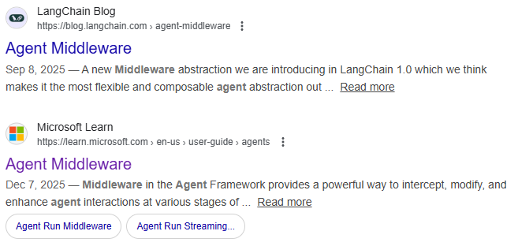
0.1 Middleware: Middleware is introduced by LangChain, not ReAct architecture
If you still remember what we discussed previously about ReAct, you can notice that ReAct has nothing to do with Middleware.
Middleware seems to be only available in LangChain and Microsoft Agents framework, so you won’t learn this in other agents building platforms, at the time I was writing this slide (i.e. Dec 30th, 2025).

Slide 4
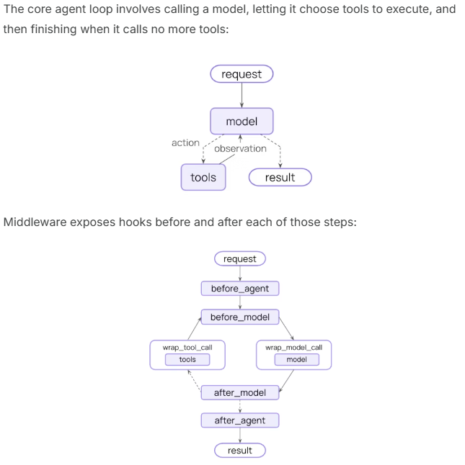
0.2 Middleware: Why we should learn Middleware and What does it mean?
Middleware can help you control the agent behavior further than regular configurations.
Let me draw a graph for you to help you understand better.
Request
Before Agent
Agent
(Tbh, it’s really hard to position wrap_model_call and wrap_tool_call 😭)
Before Model
Model
Wrap Model Call
Tools
Wrap Tool Call
After Model
After Agent

Slide 5
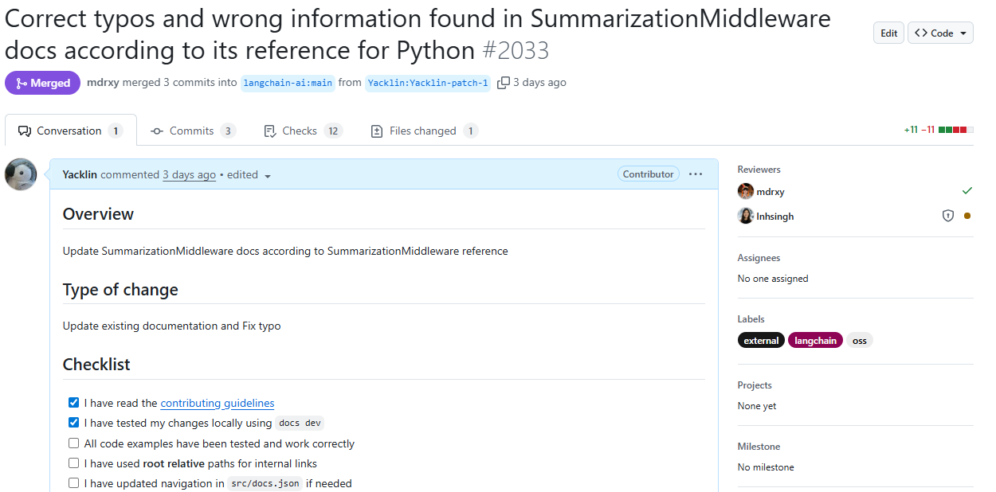
0.3 Middleware: Your learning outcome is to understand built-in Middleware
I think right now you are able to understand Middleware-related content we skipped at last presentation.
Also, I assume you are able to read the Built-in middleware section on your own right now.
I would go over some (or all) built-in middleware with you (I would jump to LangChain docs website. What’s more, LangChain provides video tutorials and feel free to watch if you like!)
By the way, when preparing this slide, I noticed there are some issues in the documents of built-in Middleware, so I proposed a fix to LangChain, and they approved then merged my fix.
But my fix has a typo, can you point it out?
I think Michael would provide bonus to you for doing this.

Slide 6
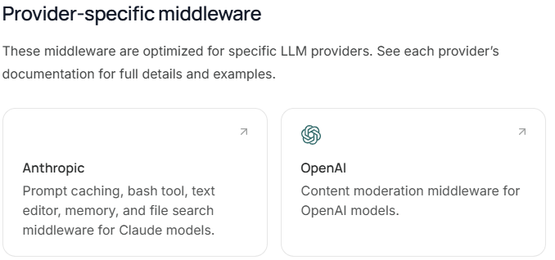
0.4 Middleware: Some Middleware are optimized for some vendors
Good to know…

Slide 7
1. Custom Middleware

Slide 8
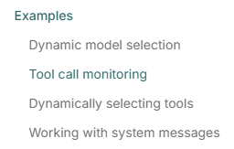
1.1 Custom Middleware: Read their examples
Control agent’s behavior in a way you like. You could control almost everything to meet your, or your employer’s needs.
Read their examples to be comfortable with it.

Slide 9
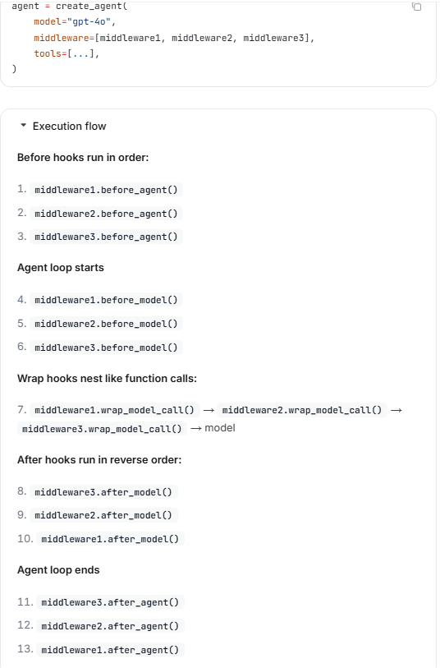
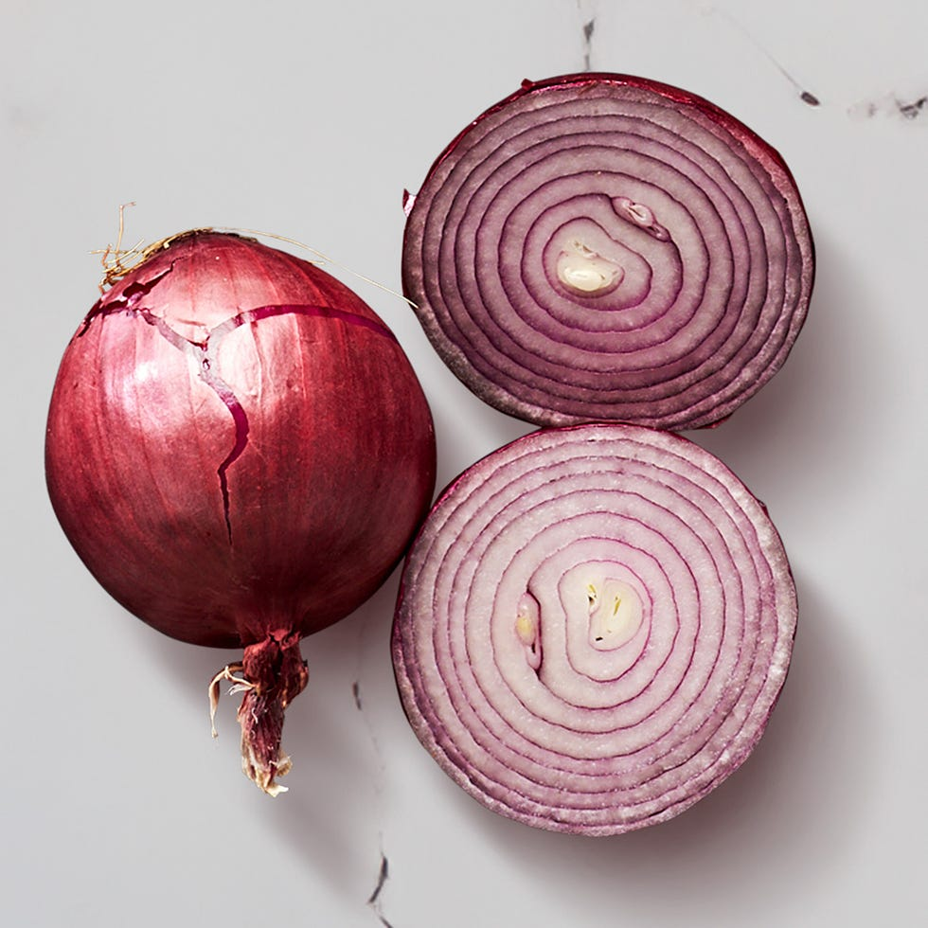
1.2 Custom Middleware: Execution Order
Order of middleware being passed in matters.
These rules remind me of structure of Onion………
Hope it helps you understand!

Slide 10
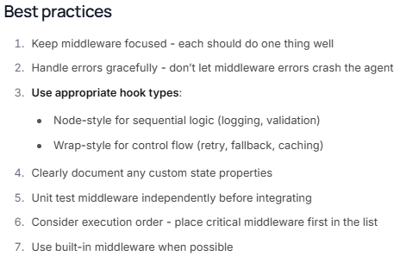
1.2 Custom Middleware: Advice when playing with Middleware
In conclusion, make sure you understand what you are doing!

Slide 11
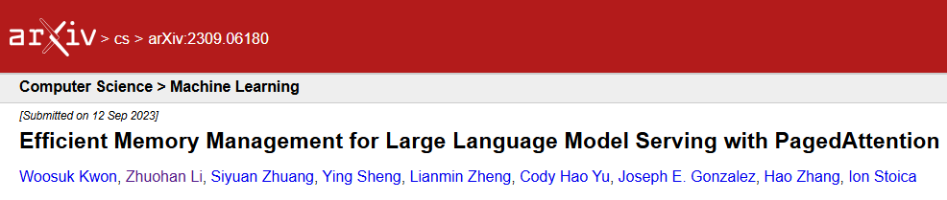
Thank you for your paged attention!

Slide 12


